Slide 1
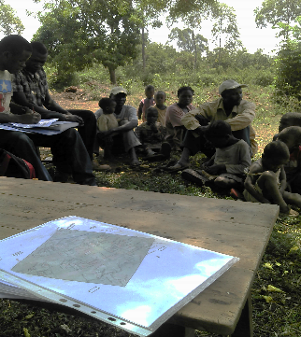
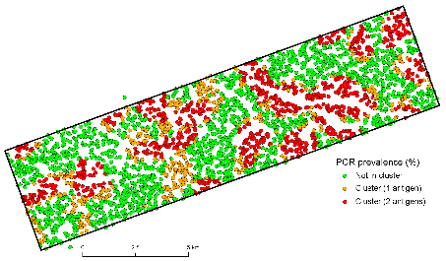
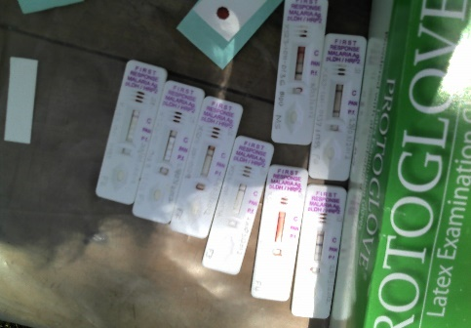
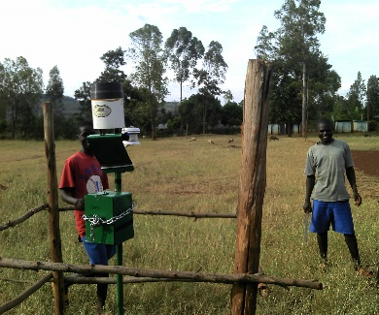
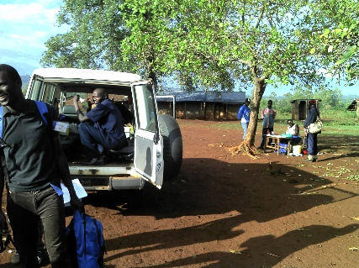
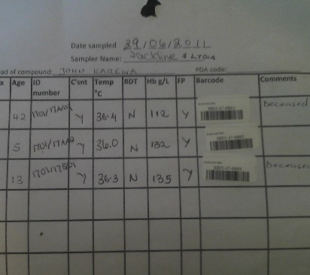
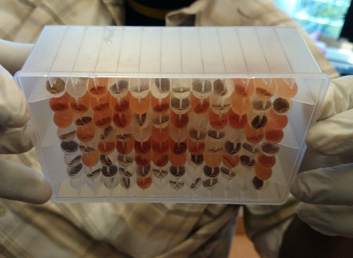
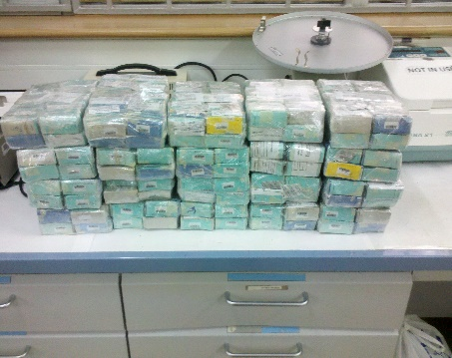
The current challenges with data analyses tools and training for Field-epidemiologists
can we jointly propose a way forward?
Amrish Baidjoe

Slide 2
What is field-epidemiology?
Field Epidemiology involves the application of epidemiologic methods to unexpected health problems when a rapid, on-site investigation is necessary for timely intervention.¹
The practice of epidemiology in the field, i.e., in the community, commonly in a public health service, i.e., a unit of government or a closely allied institution. Field epidemiology is how epidemics and outbreaks are investigated, and it is a tool for implementing measures to protect and improve the health of the public. Field epidemiologists must deal with unexpected, sometimes urgent problems that demand immediate solution. Its methods are designed to answer specific epidemiologic questions in order to plan, implement and/or evaluate public health interventions. These studies must consider the needs of those who will use the results. The task of a field epidemiologist is not complete until the results of a study have been clearly communicated in a timely manner to those who need to know, and an intervention made to improve the health of the people.²
¹ Gregg MB, ed. Field Epidemiology. Oxford University Press. New York. 1996.
² Last JM. A Dictionary of Epidemiology. Fourth Edition. Oxford University Press. New York. 2001

Slide 3
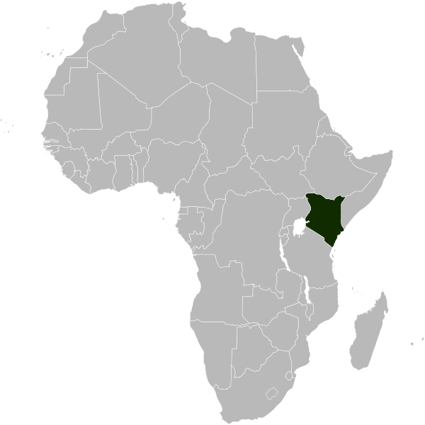
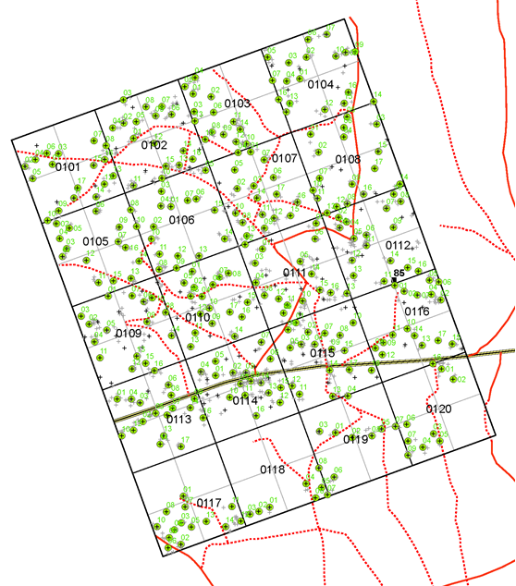

Slide 4
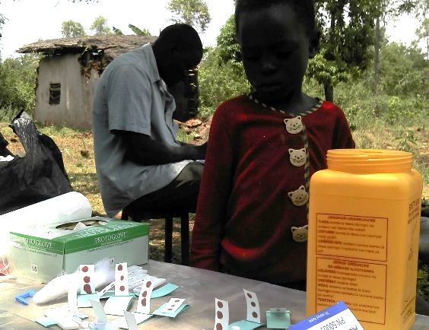
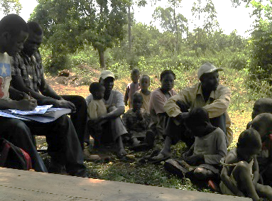
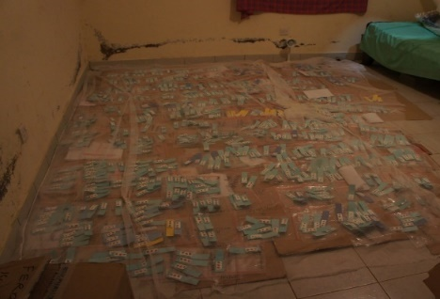
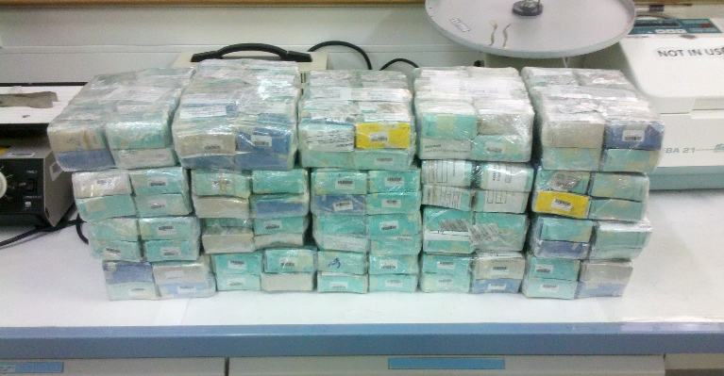
My experience; operational research, intervention implementation
90% logistics; data
Collection (semi-digital)
Merging (sample + epi 1 +epi 2)
Cleaning, recleaning
Problem solving (communication)
Narrow time frames for analyses
Time for actual work?

Slide 5
What does that make a field-epidemiologist?
MPH
OM
RAS
MVA
MD
Doctors //
HC staff
MAN
Social
Sciences
P5
INTRO
P4
Science
P3
P2
P1
PhD. science
Field Epidemiology Training

Slide 6
What does that make a field-epidemiologist?
“Persons with a diverse background but with a common analytical skillset (a methodological common language) who can collect and combine information from different sources, analyse it, condense it and advice, execute and evaluate intervention strategies with a direct positive benefit on the health of communities”

Slide 7
But what is it really?
Methodological background
Adaptive
Knows which questions to ask, and how to answer them (connecting islands)

Slide 8
What is a field-epidemiologist in an outbreak?
Field-diagnoses
expert
Bio-informatician
Others
Communities
Clinicians //
HC staff
Microbiologists
Social Scientists/ Anthropologist
Logistics support
Political stakeholders
Parasitologists
Virologist
Bacteriologist
Field-epidemiologist
Epidemiologist
Data managers
Mathematical
Modellers

Slide 9
Solar powered superhuman

Slide 10
Detective

Slide 11
The other side: Those who need Field-epidemiologists
Type of Organisation
- Where to you deploy to and where not
- What you consider an area for action, and what not (sufficient public health emergencies)
1
Context specific needs
- Country
- Type of outbreak
- Type of expertise required
2
Common denominators
3

Slide 12
The common language
A good basic epidemiological skillset:
Basic descriptive analyses
Risk factor analyses
Understand the designations of all other actors, and communicate based on the most complete picture you can get
Understand analyses from a line list only forms a partial representation of reality

Slide 13
On the training side; with random numbers (fake news)
99.5% of the outbreaks/emergencies are not Ebola
99% of the outbreaks do not involve novel pathogens
99.3% of the outbreaks do not require novel approaches (lab, analyses, intervention)
99% of outbreaks require basic tools to target the operational response; This is not done consistently and efficient at the moment (we can gain a lot here)

Slide 14
Deployment capacity on the rise and new challenges
Complex settings (Conflict, Mass-displacement)
More FETPs
More organisations with deployment capacity
Lot of heterogeneity
Further unification of methods

Slide 15
Back to the fundament
What is the goal of the operational response?
Reduce mortality/morbidity (trauma) caused by a pathogen/event
What (type of) questions do we need to answer? (data requirements?)
What tools do we need to answer these questions?

Slide 16
So what are the most common problems (and why I was afraid of R)?
Loads of Islands
1
Desk - Epidemiologists
Field – Epidemiologists
Mathematical modellers
Microbiologists
others
Too much differentiation in methodologies (including validation of packages)
2
hard to compare data
R has a lot of potential but a very steep learning curve to generate understandable output
3

Slide 17
Neglected communication and dissemination of results
Setting up an effective response
Bottleneck in operational responses is often not caused by lack of data/methodologies
By increasing data efficiency on all sides, we can focus on what we should be focussing on; data driven action (advocacy), solve a problem

Slide 18
So how does RECON aim to assist
Bringing people and actors closer together; a consortium that jointly develops new tools and training, as close to reality as possible
Our packages must fulfil three key aspects:
Efficiency: tools can be used in real time, improving situation awareness and inform intervention strategies
Reliability: tools thoroughly and constantly tested using professional software development methods
Accessibility: tools are free, open-source, available on virtually any platform; can be used with different levels of expertise, provide graphical user interfaces implementing the most important functionalities

Slide 19
What do we need?
Data cleaning
dictionaries, entry matching/merging
Graphics
case incidence in space and time, contact tracing
Parameter estimation
key delays, transmissibility
Estimate / test CFR
gender, health care workers, treatments
Predictions
case incidence, mortality, evaluate interventions
Consistent reporting
(semi-) automated situation reports

Slide 21
Keeping methodologists close to reality (and showing operational people, what the possibilities are)
Not all packages are currently useful for emergency field activities
Output difficult to interpret
Input very specific
Not user-friendly
Retrospective analyses
Very theoretical
It is cool, but doesn’t help
That is why we are here today (and yesterday)

Slide 22
So how does RECON aim to solve this
Besides its active involvement in the creation of tools, RECON is also dedicated to:
disseminating knowledge: Training platform, workshops and short courses on epidemics analysis and outbreak response. (not only through FETPs)
Our public forum is also dedicated to sharing expertise on these topics
Outbreak response deployment: Supporting the deployment of data analysts to the field as part of outbreak response teams; this includes the deployment of staff as well as analysis systems adapted to low resources settings

Slide 23
Today
Presentations to set the stage
Guiding the RECON community
“The aim of this meeting is to exchange viewpoints and ideas and possibly make a start on jointly realising new initiatives and ideas, humble starts”
Discussions and generation of action points in groups of 4
Presentations of 4 groups

Slide 24
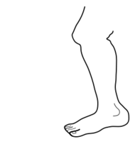
R Epidemics Consortium
www.repidemicsconsortium.org

